Slide 1
Autoai model building using ibm Watson studio
Shreya Singh
B.Tech-CS(AIML)
United College of Engineering and Research, Prayagraj

Slide 2

Abstract
.
To minimize manual intervention in feature engineering and model selection.
This project focuses on building a machine learning model to predict house prices based on property features like area and location. The model was developed using IBM Watson Studio’s AutoAI, which automates data preprocessing, model selection, and tuning. The dataset consists of 200 records with area and pricing details. By leveraging AutoAI, the project eliminates manual steps and ensures a fast and efficient way to generate accurate regression models. The outcome provides insights into the real estate market and demonstrates the power of automated ML pipelines in predictive analytics.

Slide 3
Problem Statement
Traditional manual valuation methods are often time-consuming and may lack consistency. This project aims to automate the model-building process using IBM Watson Studio's AutoAI to develop a machine learning model that predicts house prices based on various features such as area, location, number of bedrooms, and property age.

Slide 4

Objectives
Automate the machine learning model-building process
Analyze the key factors (such as area) that influence house pricing.
Build a regression model using historical housing data.
Evaluate multiple models generated by AutoAI
Minimize manual intervention in feature engineering and model selection.

Slide 5
Dataset Description
Dataset-
Area (sq.ft) | Pricing (₹ in lakhs)
1000 | 55
1200 | 62
1500 | 75
1800 | 85
2000 | 92
The dataset used in this project contains 200 rows representing housing data. It includes two key features:
Area (in square feet):
A numerical feature representing the size of the house or apartment.
Pricing (in lakhs):
The target variable, indicating the actual price of the house.

Slide 6
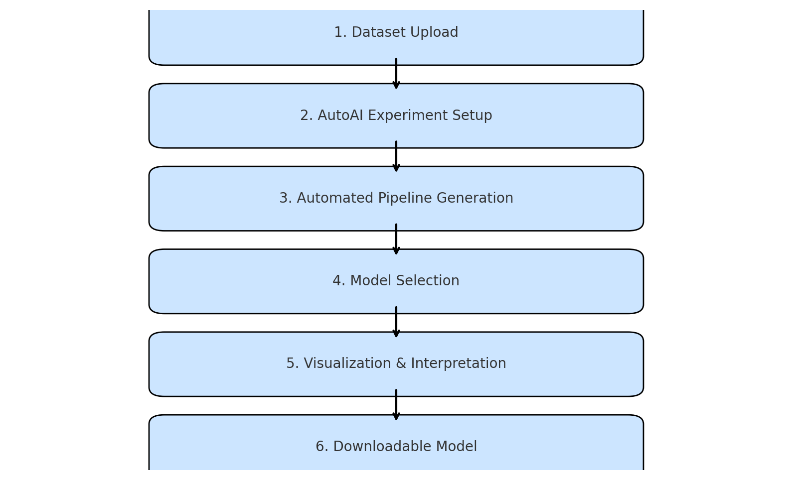
Methodology
The methodology followed in this project involves the following steps, automated using IBM Watson Studio's AutoAI:

Slide 7
Technology Used
IBM Watson Studio
AutoAI
Python
CSV File Format

Slide 8


Model Building
The dataset was uploaded to IBM Watson Studio and an AutoAI experiment was created.
AutoAI automatically:
Performed data preprocessing
Generated multiple regression pipelines
Tuned hyperparameters
Ranked models based on performance
Top-performing model selected: Linear Regression

Slide 9

Conclusion
The project successfully built a house price prediction model using IBM Watson Studio’s AutoAI.
AutoAI automated the entire machine learning pipeline — including data preprocessing, feature engineering, and model selection.
The model demonstrated a strong positive correlation between area and price, validating the use of regression techniques.
Reduced manual effort while maintaining high accuracy.
This project proves that automated machine learning can simplify and accelerate predictive analytics in real-world scenarios.

Slide 10
Thank you

